Slide 1
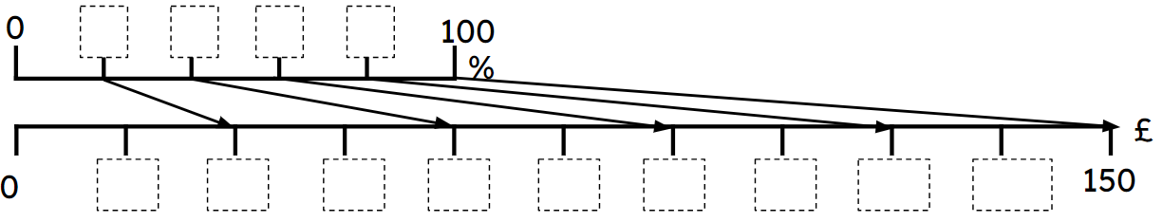
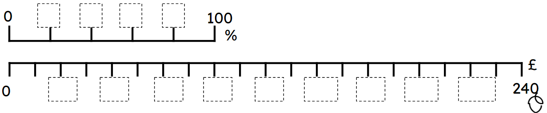
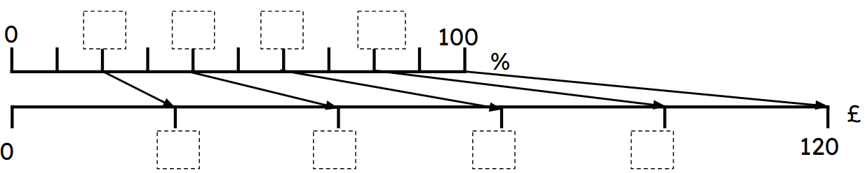
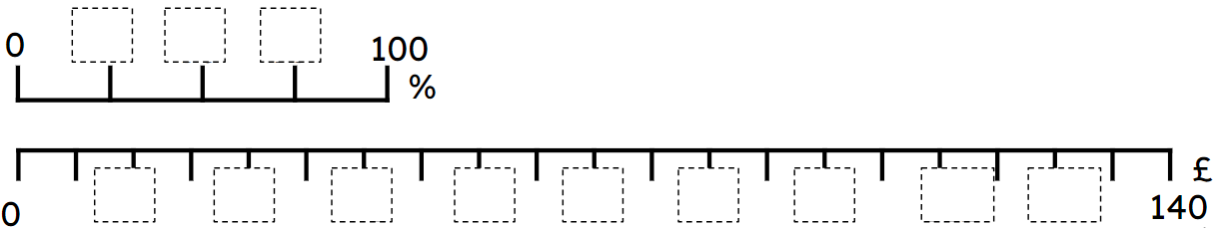
Scaling diagrams for multiplicative relationships
Task A: Scaling diagrams
Fill in the missing information (including arrows) using the scaling diagrams.
a)
20
40
60
80
Show 60% of 150 = 90
15
30
45
60
75
90
105
120
135
b)
20
40
60
80
Show 40% of 240 = 96
20 ÷ 5 = 4 intervals for each 20%
24
48
72
96
120
144
168
192
216
240
2) Fill in the missing information (including arrows) using the scaling diagrams.
a)
Show 60% of 120 = 72
20
40
60
80
24
48
72
96
b)
25
50
75
Show 75% of 140 = 105
14
28
42
56
70
84
98
112
126

Slide 2
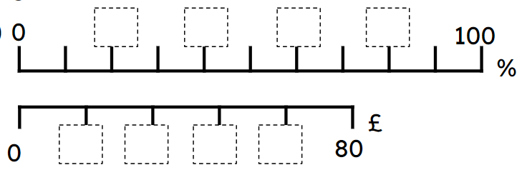
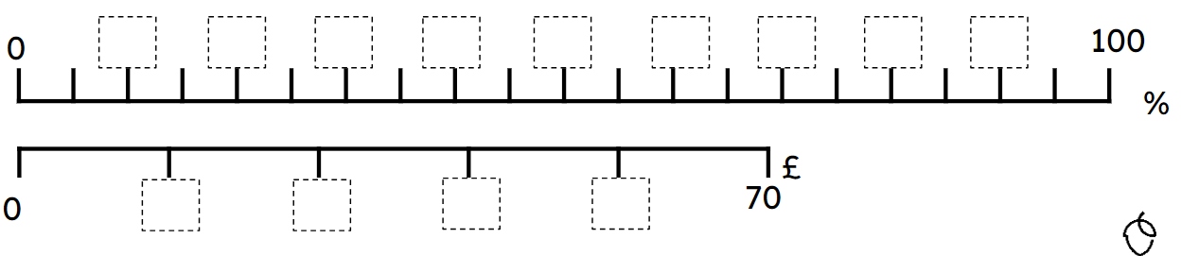
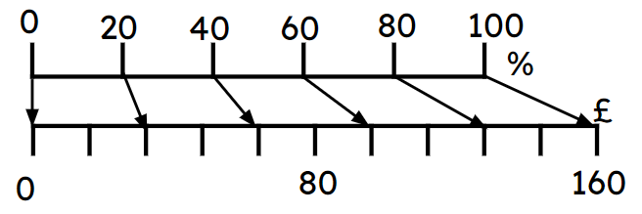
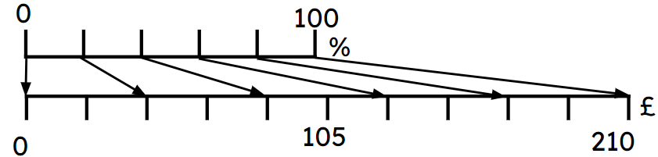
Scaling diagrams for multiplicative relationships
3) Fill in the missing information (including arrows) using the scaling diagrams.
a)
20
40
60
80
Show 60% of 80 = 48
16
32
48
64
Show 40% of 70 = 28
b)
10
20
30
40
50
60
70
80
90
14
28
42
56
Task B: Comparing representations
1) Fill in the missing information on the ratio table and the scaling diagram.
Amount | %
 | 100
 | 40
 | 15
160
×1.6
×1.6
64
24
Amount | %
 | 100
 | 60
 | 24
210
×2.1
×2.1
126
50.4

Slide 3
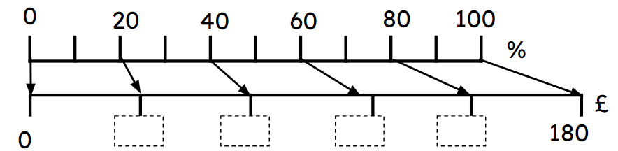
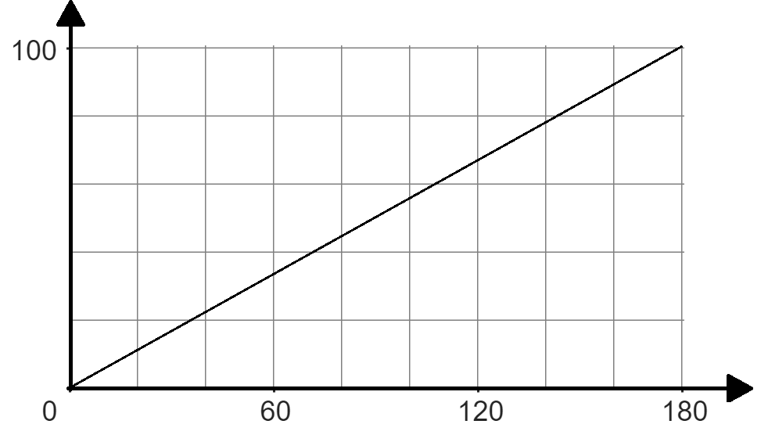
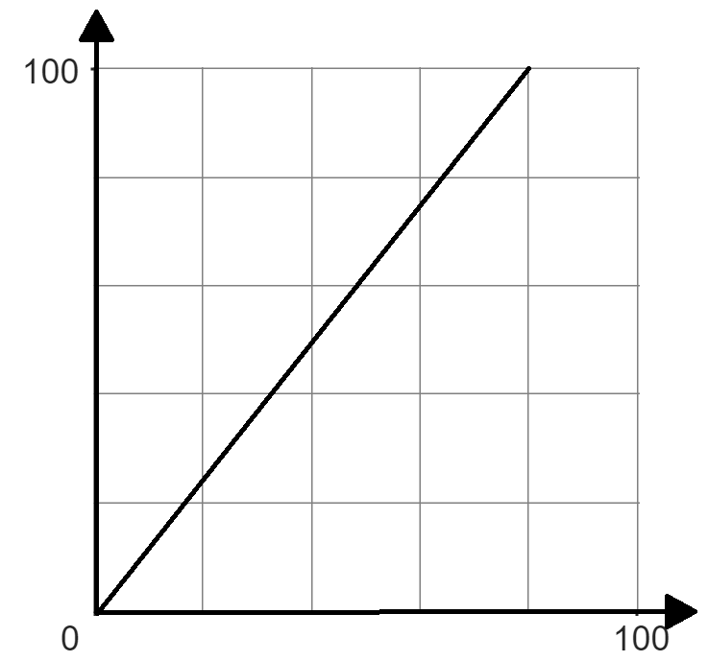
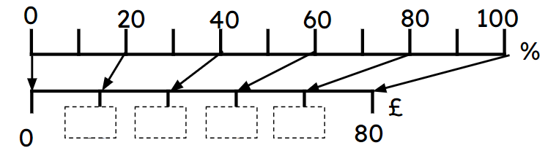
Scaling diagrams for multiplicative relationships
2a) Fill in the missing information, using the different representations.
Amount | %
 | 100
 | 40
 | 15
×1.8
× 1.8
180
72
36
72
108
144
27
%
40
100
100
%
72
180
£
72
180
£
%
2b) Fill in the missing information, using the different representations.
Amount | %
 | 100
 | 50
32
0.4
80
×0.8
40
40
£
0.5
£
50
%
80
£
16
32
48
64
× 0.8
40
Mathematics in Education and Industry
v2.3

